Slide 1
Start
Application ID : VK26-IITI-AHM-0321

Slide 2
ProteanCNC
Team ID : VK26-IITI-AHM-0321
Track :
Innovation : An AI-powered modular CNC that simplifies multi-process fabrication through interchangeable toolheads and automated workflows.

Slide 3
Problem Statement
Hobbyists and makers often require multiple specialized machines, such as 3D printers, CNC routers, laser engravers, and pick-and-place machines, to manufacture different components and prototypes. This leads to high equipment costs, space constraints, fragmented software workflows, and the need for technical expertise to operate each machine. Furthermore, transitioning between different manufacturing processes often requires manual intervention, tool changes, and repeated configuration. There is a need for an affordable, modular fabrication platform that integrates multiple manufacturing capabilities and intelligently coordinates tool selection and execution from high-level user instructions, simplifying the overall production pipeline for hobbyists.

Slide 4
User Journey Before
Flowchart here

Slide 5
User Journey After
Flowchart here

Slide 6
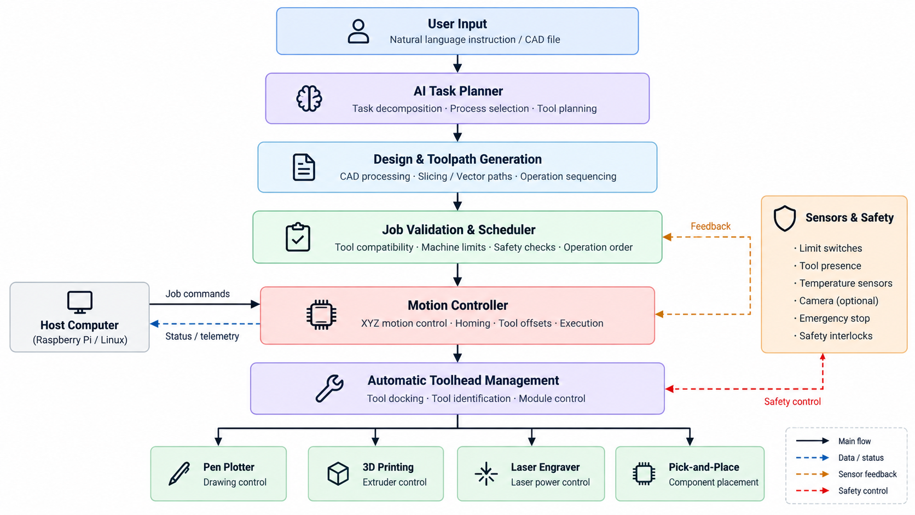
System Block Diagram

Slide 7
Specifications and Hardware

Slide 8
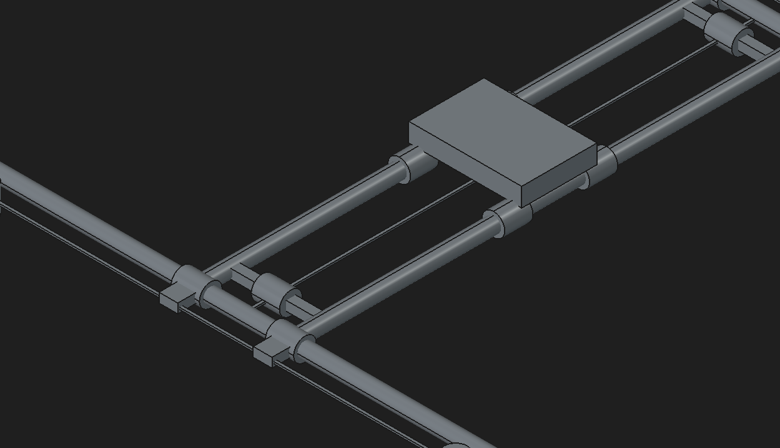
CAD Design And Specs

